Slide 1
COURSE OF FRENCH REVOLUTION
5TH MAY 1789= THREE ESTATES MEETING
17TH JUNE 1789 = NATIONAL ASSEMBLY
20TH JUNE 1789= TENNIS COURT OATH (Never To Separate And To Reassemble Wherever Circumstances Shall Require Until The Constitution Of The Kingdom Shall Be Established)
23RD JUNE 1789= ROYAL GATHERING (Three Estates Together, Third Illegal and Unconstitutional)

Slide 2
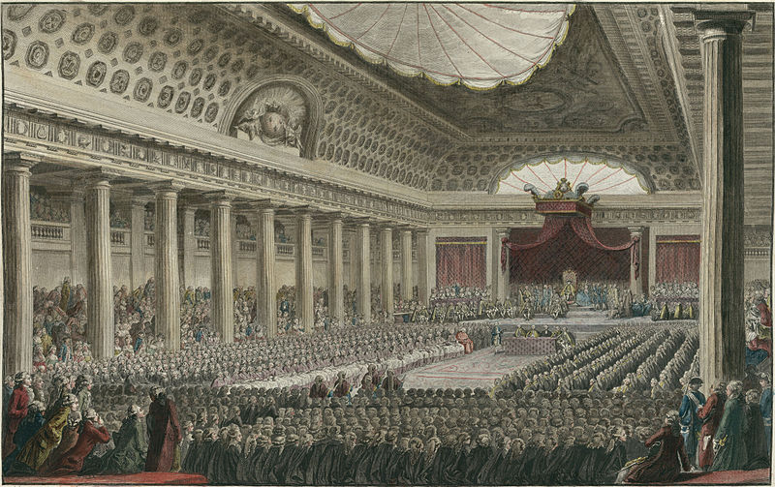

Slide 3
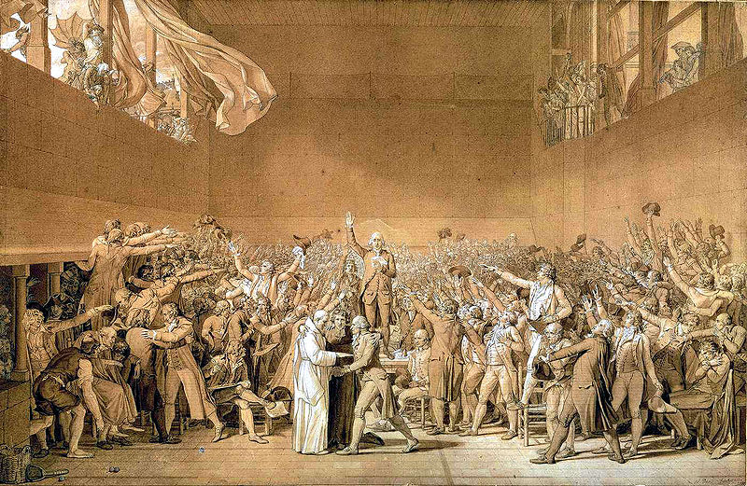

Slide 4
COURSE OF FRENCH REVOLUTION
25TH JUNE 1789= CLERGY AND NOBLE
27TH JUNE 1789 = ONE SITTING
11TH JULY 1789= DISMISSAL OF NECKER AND TEAM
14TH JULY 1789= FALL OF BASTILLE
ALL TOWNS AND VILLAGES= NATIONAL GUARDS
WOMEN PROCESSION

Slide 5
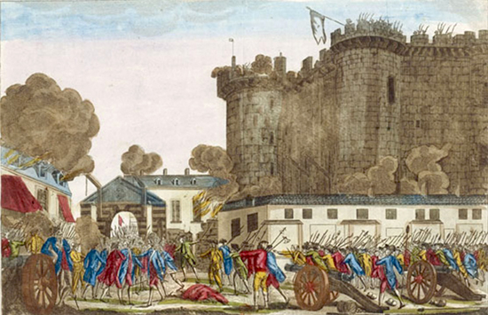

Slide 7
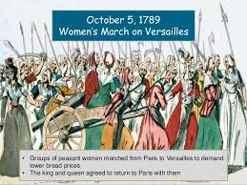

Slide 8
CONSEQUENCES OF FRENCH REVOLUTION
Over Throw of Bourbon Monarchy
Abolition of Feudalism
Abolition of Slavery
Drafting of New Constitution
Establishment of Constitutional Monarchy
Spread of New Ideas
Emergence of New Economic System
New Forms of Government
Military Unification of France
Napoleon and Napoleonic Codes

